Slide 1
Naming Technologies within
Distributed Systems
Names, Identifiers and Addresses

Slide 2
Naming
Naming systems play an important role in all computer systems, and especially within a distributed environment.
The three main areas of study:
  The organisation and implementation of human-friendly naming systems.
  Naming as it relates to mobile entities.
  Garbage collection – what to do when a name is no longer needed.

Slide 3
Some Definitions
Name – a string (often human-friendly) that refers to an entity.
Entity – just about any resource.
Address – “access-point” of an entity.
A name for an entity that is independent of an address is referred to as “location independent”.
Identifier – a reference to an entity that is
often unique and never reused.

Slide 4
Namespaces
Names are often organised into namespaces.
  Within distributed systems, a namespace is represented by a labelled, directed graph with two types of nodes:
    leaf nodes: information on an entity.
    directory nodes: a collection of named outgoing edges (which can lead to any other type of node).
  Each namespace has at least one root node.
  Nodes can be referred to by path names (with absolute or relative).
  File systems are a classic example…

Slide 5
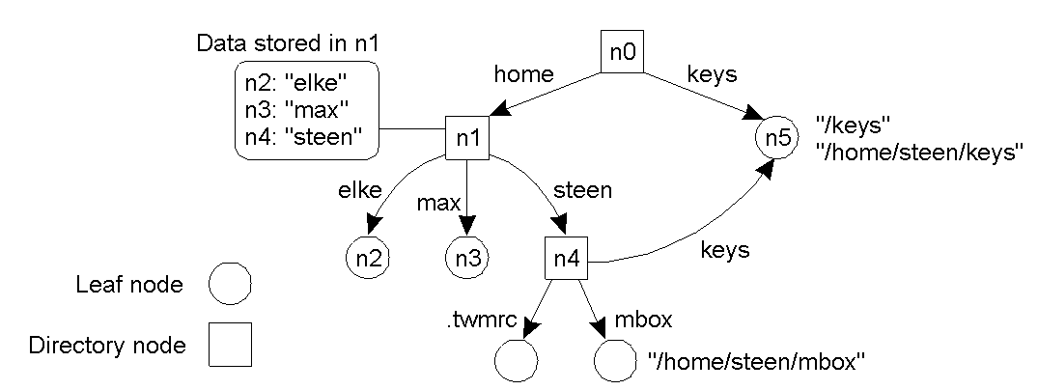
Name Spaces and Graphs
A general naming graph with a single root node, showing relative and absolute path names.

Slide 6
Other Name Space Examples
UNIX file system implementation
  With NFS enhancements to support “remote mounting” of remote file systems.
SNMP MIB-II
  “sub-namespace” within a much larger namespace maintained by the ISO.
DNS (more on this later).

Slide 7
Introducing Name Resolution
The process of looking up information stored in the node given just the path name.
  Assuming that you know where to start (bootstrap lookup address of naming service)…
This can be complicated by techniques that have been devised to combine namespaces
  such as Sun’s NFS mounting and DEC’s GNS…

Slide 8
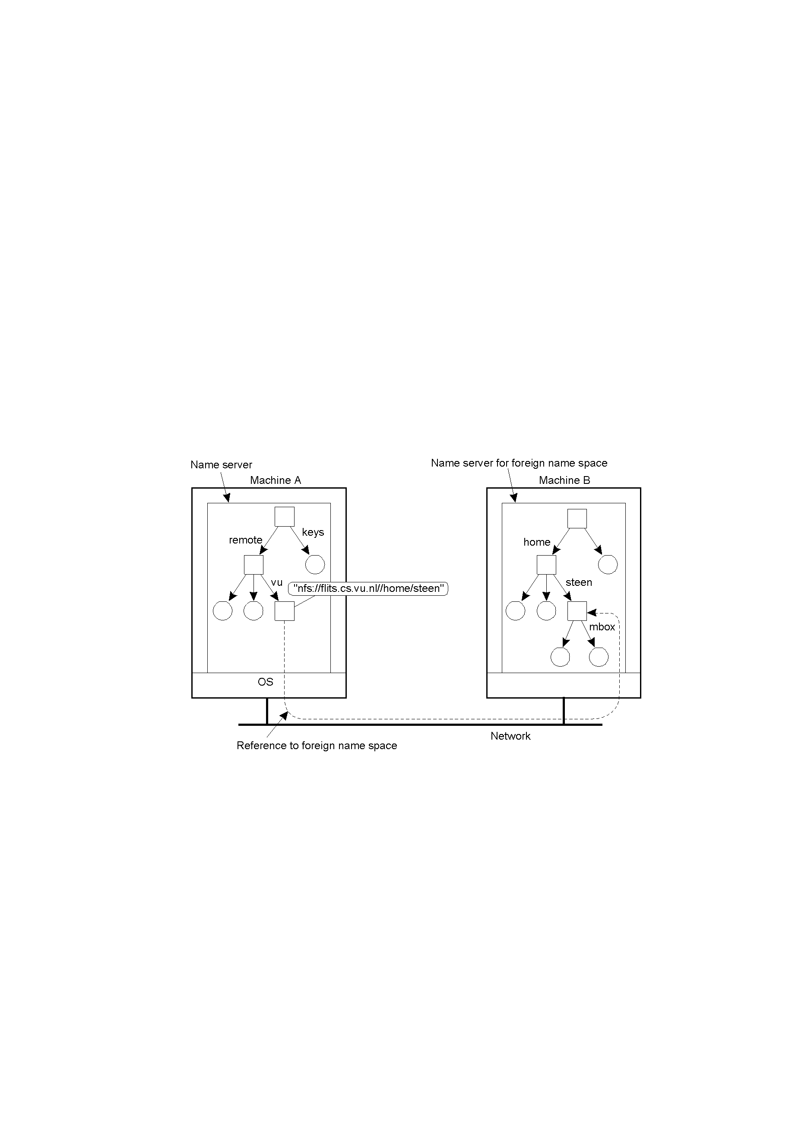
Linking and Mounting (1)
Mounting remote name spaces through a specific process protocol (e.g. Sun’s Network File System protocol - NFS).

Slide 9
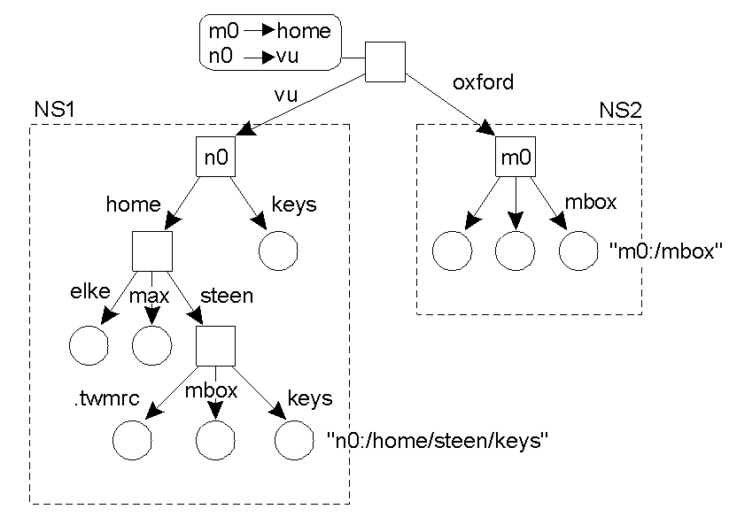
Linking and Mounting (2)
Add a new root node and makes existing root nodes its children
(e.g. organization of the DEC “Global Name Service”).

Slide 10
Implementing Namespaces
Name Service allows users and processes to add, remove and lookup names.
  Name services are implemented by Name Servers.
  LAN’s – a single server usually suffices (e.g. ‘local’ DNS).
  WAN’s – a distributed solution is often more practical (e.g. ‘global’ DNS).
Namespaces (and services) are oftenly organised into one of three layers.

Slide 11
Three Name Space Layers
Global Layer:
  highest level nodes (root); stable; entries change very infrequently.
Administrational Layer:
  directory nodes managed by a single organisation; relatively stable; although changes can occur more frequently.
Managerial Layer:
  nodes change frequently; nodes maintained by users as well as administrators; nodes are the ‘leaf entities’, and can often change.

Slide 12
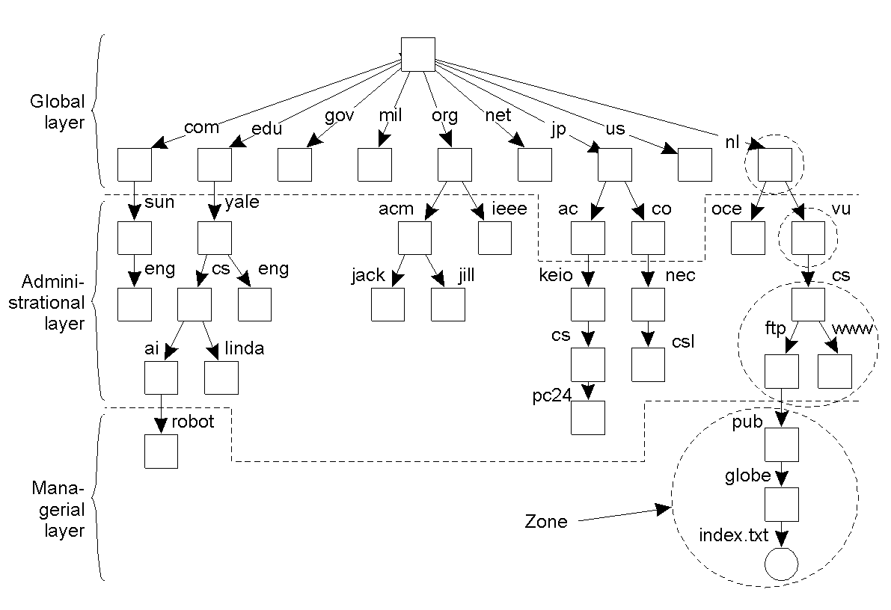
Name Space Distribution (1)
e.g. partitioning of the DNS name space, including Internet-accessible files, into the three name space layers. A “zone” in DNS is a non-overlapping part of the namespace that is implemented by a separate name server.

Slide 13
Name Space Distribution (2)
Comparing features/characteristics of name servers that implement nodes within a large-scale name space (partitioned into global, administrational and managerial layers).
Availability and performance requirements are met by replication and caching at each of the various layers (more on caching later).
Feature/Characteristic | Global | Administrational | Managerial
Geographical scale of network | Worldwide | Organization | Department
Total number of nodes | Few | Many | Vast numbers
Responsiveness to lookups | Seconds | Milliseconds | Immediate
Update propagation | Lazy | Immediate | Immediate
Number of replicas | Many | None or few | None
Is client-side caching applied? | Yes | Yes | Sometimes

Slide 14
More on Name Resolution
A “name resolver” provides a local name resolution service to clients
  responsible for ensuring that the name resolution process is carried out.
Two Common Approaches:
  1. Iterative Name Resolution.
  2. Recursive Name Resolution.

Slide 15
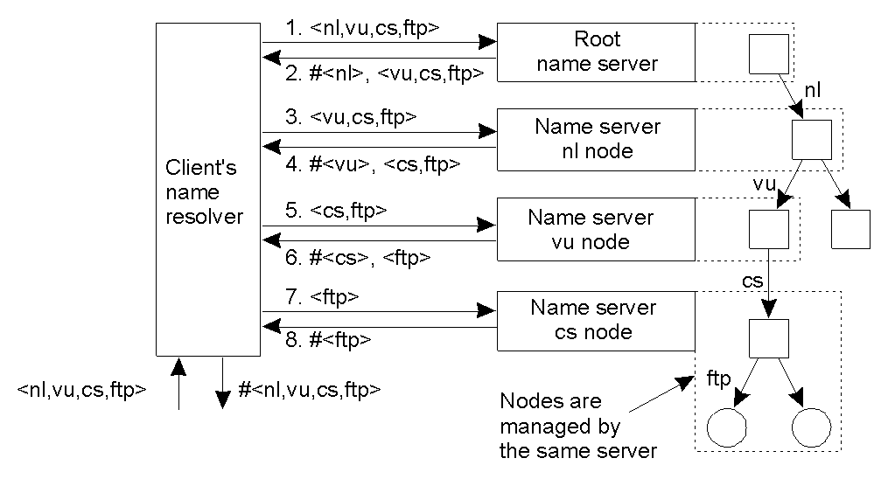
Iterative Name Resolution
The name resolver queries each name server (at each layer) in an iterative fashion (NB: the client is doing all the work here and generating a lot of traffic).

Slide 16
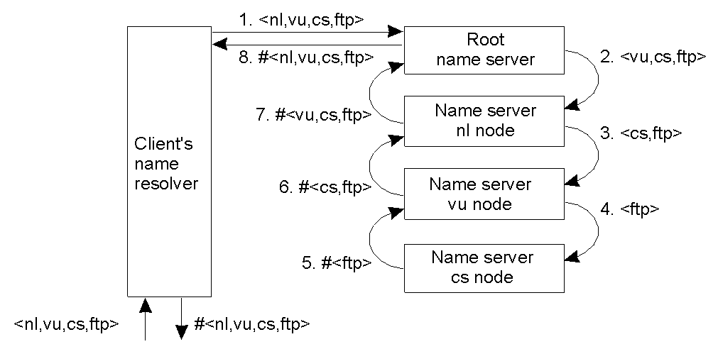
Recursive Name Resolution
The name resolver starts the process, then each server temporarily becomes a client of the next name server until the resolution is satisfied (results are then returned to the client).

Slide 17
Caching and Recursive Name Resolution
Server for node | Should resolve | Looks up | Passes to child | Receives and caches | Returns to requester
cs | <ftp> | #<ftp> | -- | -- | #<ftp>
vu | <cs,ftp> | #<cs> | <ftp> | #<ftp> | #<cs> #<cs, ftp>
ni | <vu,cs,ftp> | #<vu> | <cs,ftp> | #<cs> #<cs,ftp> | #<vu> #<vu,cs> #<vu,cs,ftp>
root | <ni,vu,cs,ftp> | #<nl> | <vu,cs,ftp> | #<vu> #<vu,cs> #<vu,cs,ftp> | #<nl> #<nl,vu> #<nl,vu,cs> #<nl,vu,cs,ftp>
Recursive name resolution of <nl, vu, cs, ftp>. Name servers cache intermediate results for subsequent lookups. This is seen as a key advantage to the recursive name resolution approach, even though the workload has been moved from the client to the servers. Nevertheless, think about subsequent lookups…

Slide 18
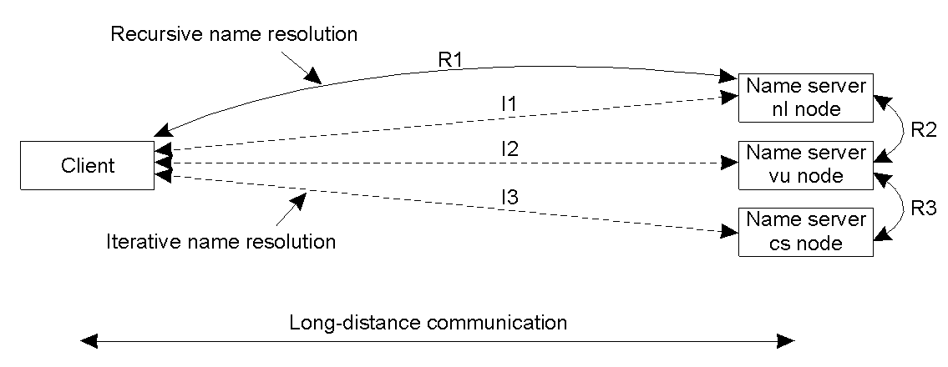
Iterative vs. Recursive Resolution
Comparison between recursive and iterative name resolution with respect to communication costs. Again, the recursive technology is generally regarded to have an advantage in this situation (especially over longer, more expensive WAN links).

Slide 19
Two Naming Examples
The Domain Name Service (DNS)
The X.500 Directory Service

Slide 20
Example: DNS
One of the largest distributed naming services in use today.
  DNS is a classic “rooted tree” naming system.
  Each label (bit between ‘.’) must be < 64 chars.
  Each path (the whole name) must be < 256 chars.
The root is given the name ‘.’ (although, in practice, the dot is rarely shown nor required).

Slide 21
DNS Names
A subtree within DNS is referred to as “domain”.
A path name is referred to as a “domain name”.
  These can be relative or absolute.
A DNS server operates at each node (except those at the bottom).
  Here, the information is organised into “resource records”.

Slide 22
DNS – Types of Resource Record
Type of record | Associated entity | Description
SOA | Zone | Holds information on the represented zone.
A | Host | Contains an IP address of the host this node represents.
MX | Domain | Refers to a mail server to handle mail addressed to this node.
SRV | Domain | Refers to a server handling a specific service.
NS | Zone | Refers to a name server that implements the represented zone.
CNAME | Node | Symbolic link with the primary name of the represented node.
PTR | Host | Contains the canonical name of a host.
HINFO | Host | Holds information on the host this node represents.
TXT | Any kind | Contains any entity-specific information considered useful.
The most important types of resource records forming the contents of nodes (and maintained by servers) in the DNS name space.

Slide 23
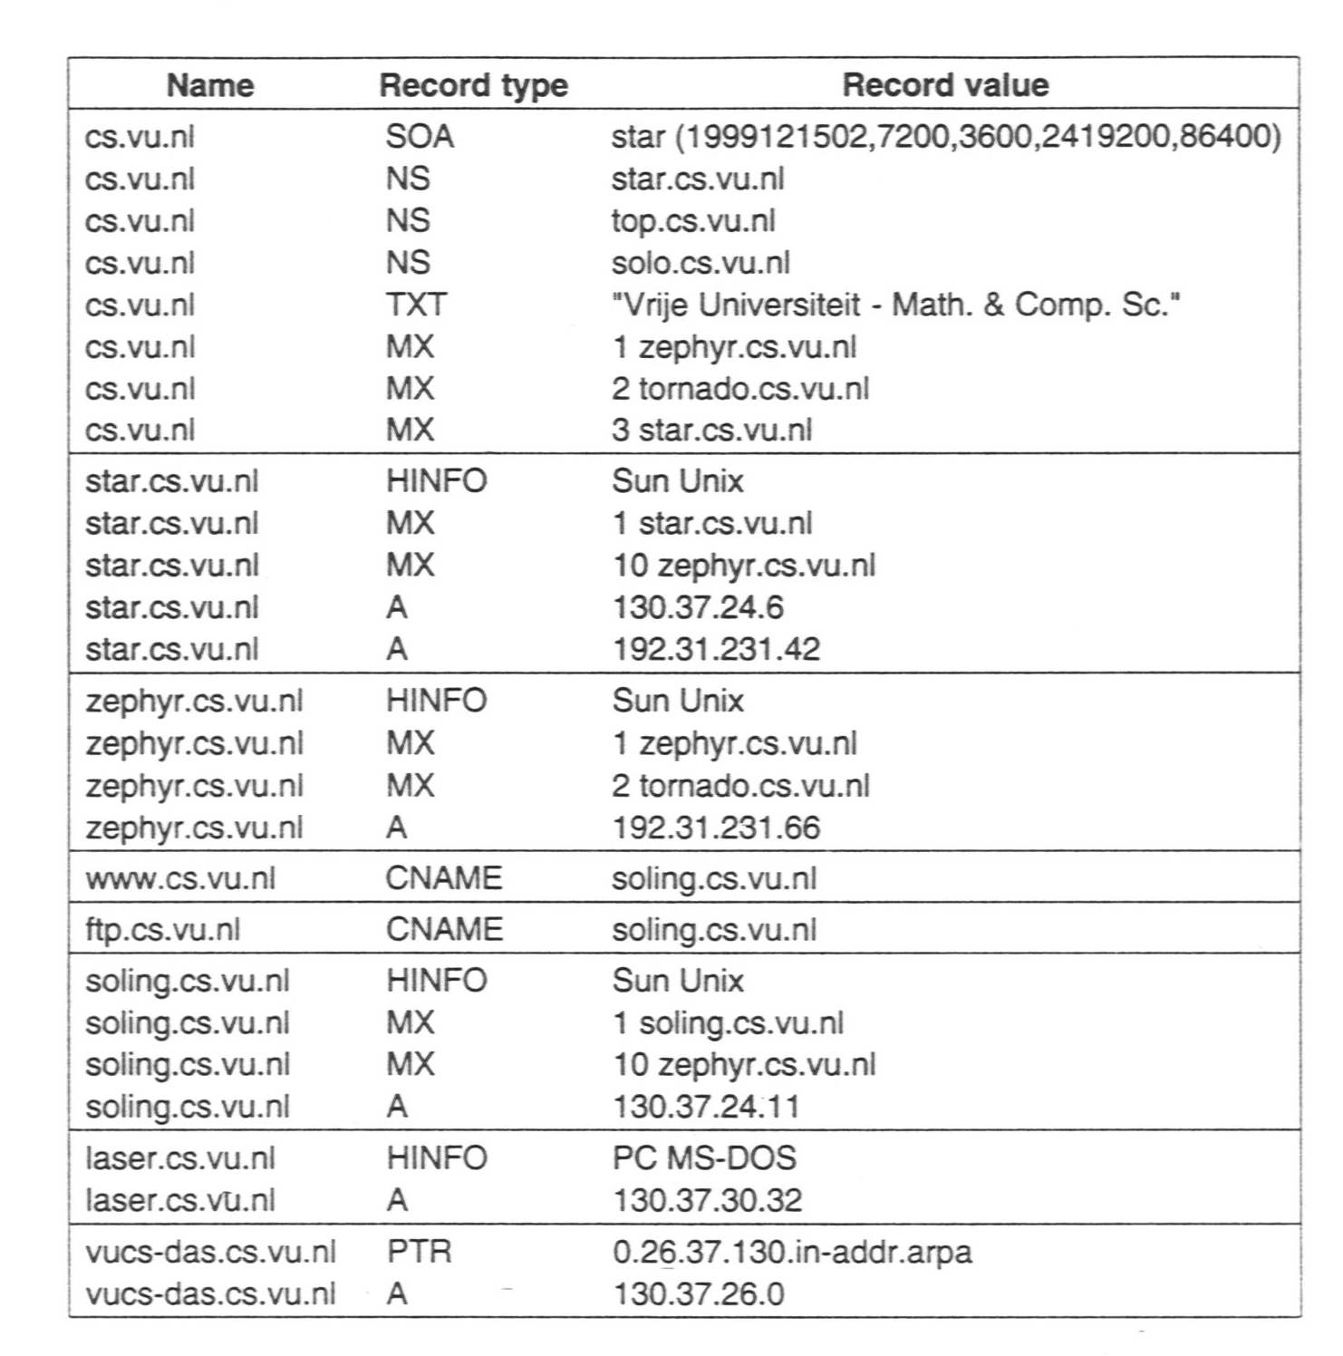
DNS Implementation
An excerpt from the DNS database for the zone cs.vu.nl.
The “database” is a small collection of files maintained within each DNS “zone”.

Slide 24
Example: X.500 Naming Service
A traditional naming service (like DNS) operates very much like the Telephone Directory.
  Find ‘B’, then find ‘Barry’, then find ‘Paul’, then get the number.
With a directory service (like X.500), the client can look for an entity based on a description of its properties instead of its full name (more like the Yellow Pages).
  Find ‘Perl Consultants’, obtain the list, search the list, find ‘Paul Barry’, then get the number.

Slide 25
More on X.500
Directory entries in X.500 are roughly equivalent to domain names in DNS.
  The entries are organised as a series of “Attribute/Value Pairings”
A collection of directory entries is referred to as a Directory Information Base (DIB).

Slide 26
X.500 Attribute/Value Pairings
Attribute | Abbr. | Value
Country | C | NL
Locality | L | Amsterdam
Organization | L | Vrije Universiteit
OrganizationalUnit | OU | Math. & Comp. Sc.
CommonName | CN | Main server
Mail_Servers | -- | 130.37.24.6, 192.31.231,192.31.231.66
FTP_Server | -- | 130.37.21.11
WWW_Server | -- | 130.37.21.11
A simple example of a X.500 directory entry using X.500 naming conventions (NB: both Microsoft and Novell have based their name space technology on the X.500 standard).

Slide 27
X.500 RDN’s and DIT’s
A collection of naming attributes is called a Relative Distinguished Name (RDN).
  RDN’s can be arranged in sequence into a Directory Information Tree (DIT).
  The DIT is usually partitioned and distributed across several servers (called Directory Service Agents – DSA).
Clients are known as Directory User Agents – DUA.

Slide 28
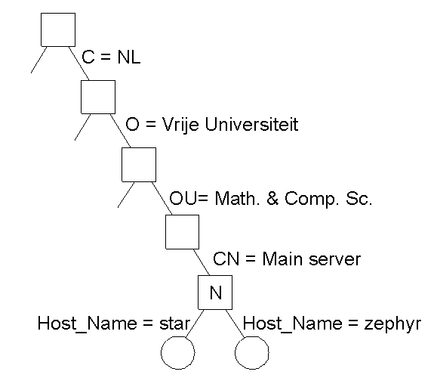
The X.500 DIT
Part of the X.500 Directory Information Tree (DIT)

Slide 29
X.500 Commentary
Searching the DIT is an expensive task.
Implementing X.500 is not trivial (as is the case with so many ISO standards).
On the Internet, a similar service is provided by the simpler Lightweight Directory Access Protocol (LDAP)
  regarded as a useful and implementable subset of the X.500 standards.

Slide 30
Locating Mobile Entities
Tricky …
Traditional naming services (DNS, X.500) are not suited for environments where entities change location (i.e. move).
The assumption is that moves occur rarely at the Global and Administrative layers, and when moves occur at the Managerial layer, the entity stays within the same domain.
But, what happens is ftp.cs.vu.nl moves to ftp.cs.unisa.edu.au?

Slide 31
Possible Solutions
A record of the new address of the entity is stored in the cs.vu.nl name server.
A record of the name of the new entity is stored in the cs.vu.nl name server (i.e. a symbolic link is created).
  Both “solutions” seem OK, until you consider what happens when the entity moves again, then again, then again…
  Consequently, both “solutions” can be shown to be inefficient and unscalable.

Slide 32
More Location Problems
Even non-mobile entities that change their name often cause name space problems – consider the DNS within a DHCP environment (currently incompatible).
  So… a different solution is needed.
What’s required is a “Location Service” (or middle-man technology).

Slide 33
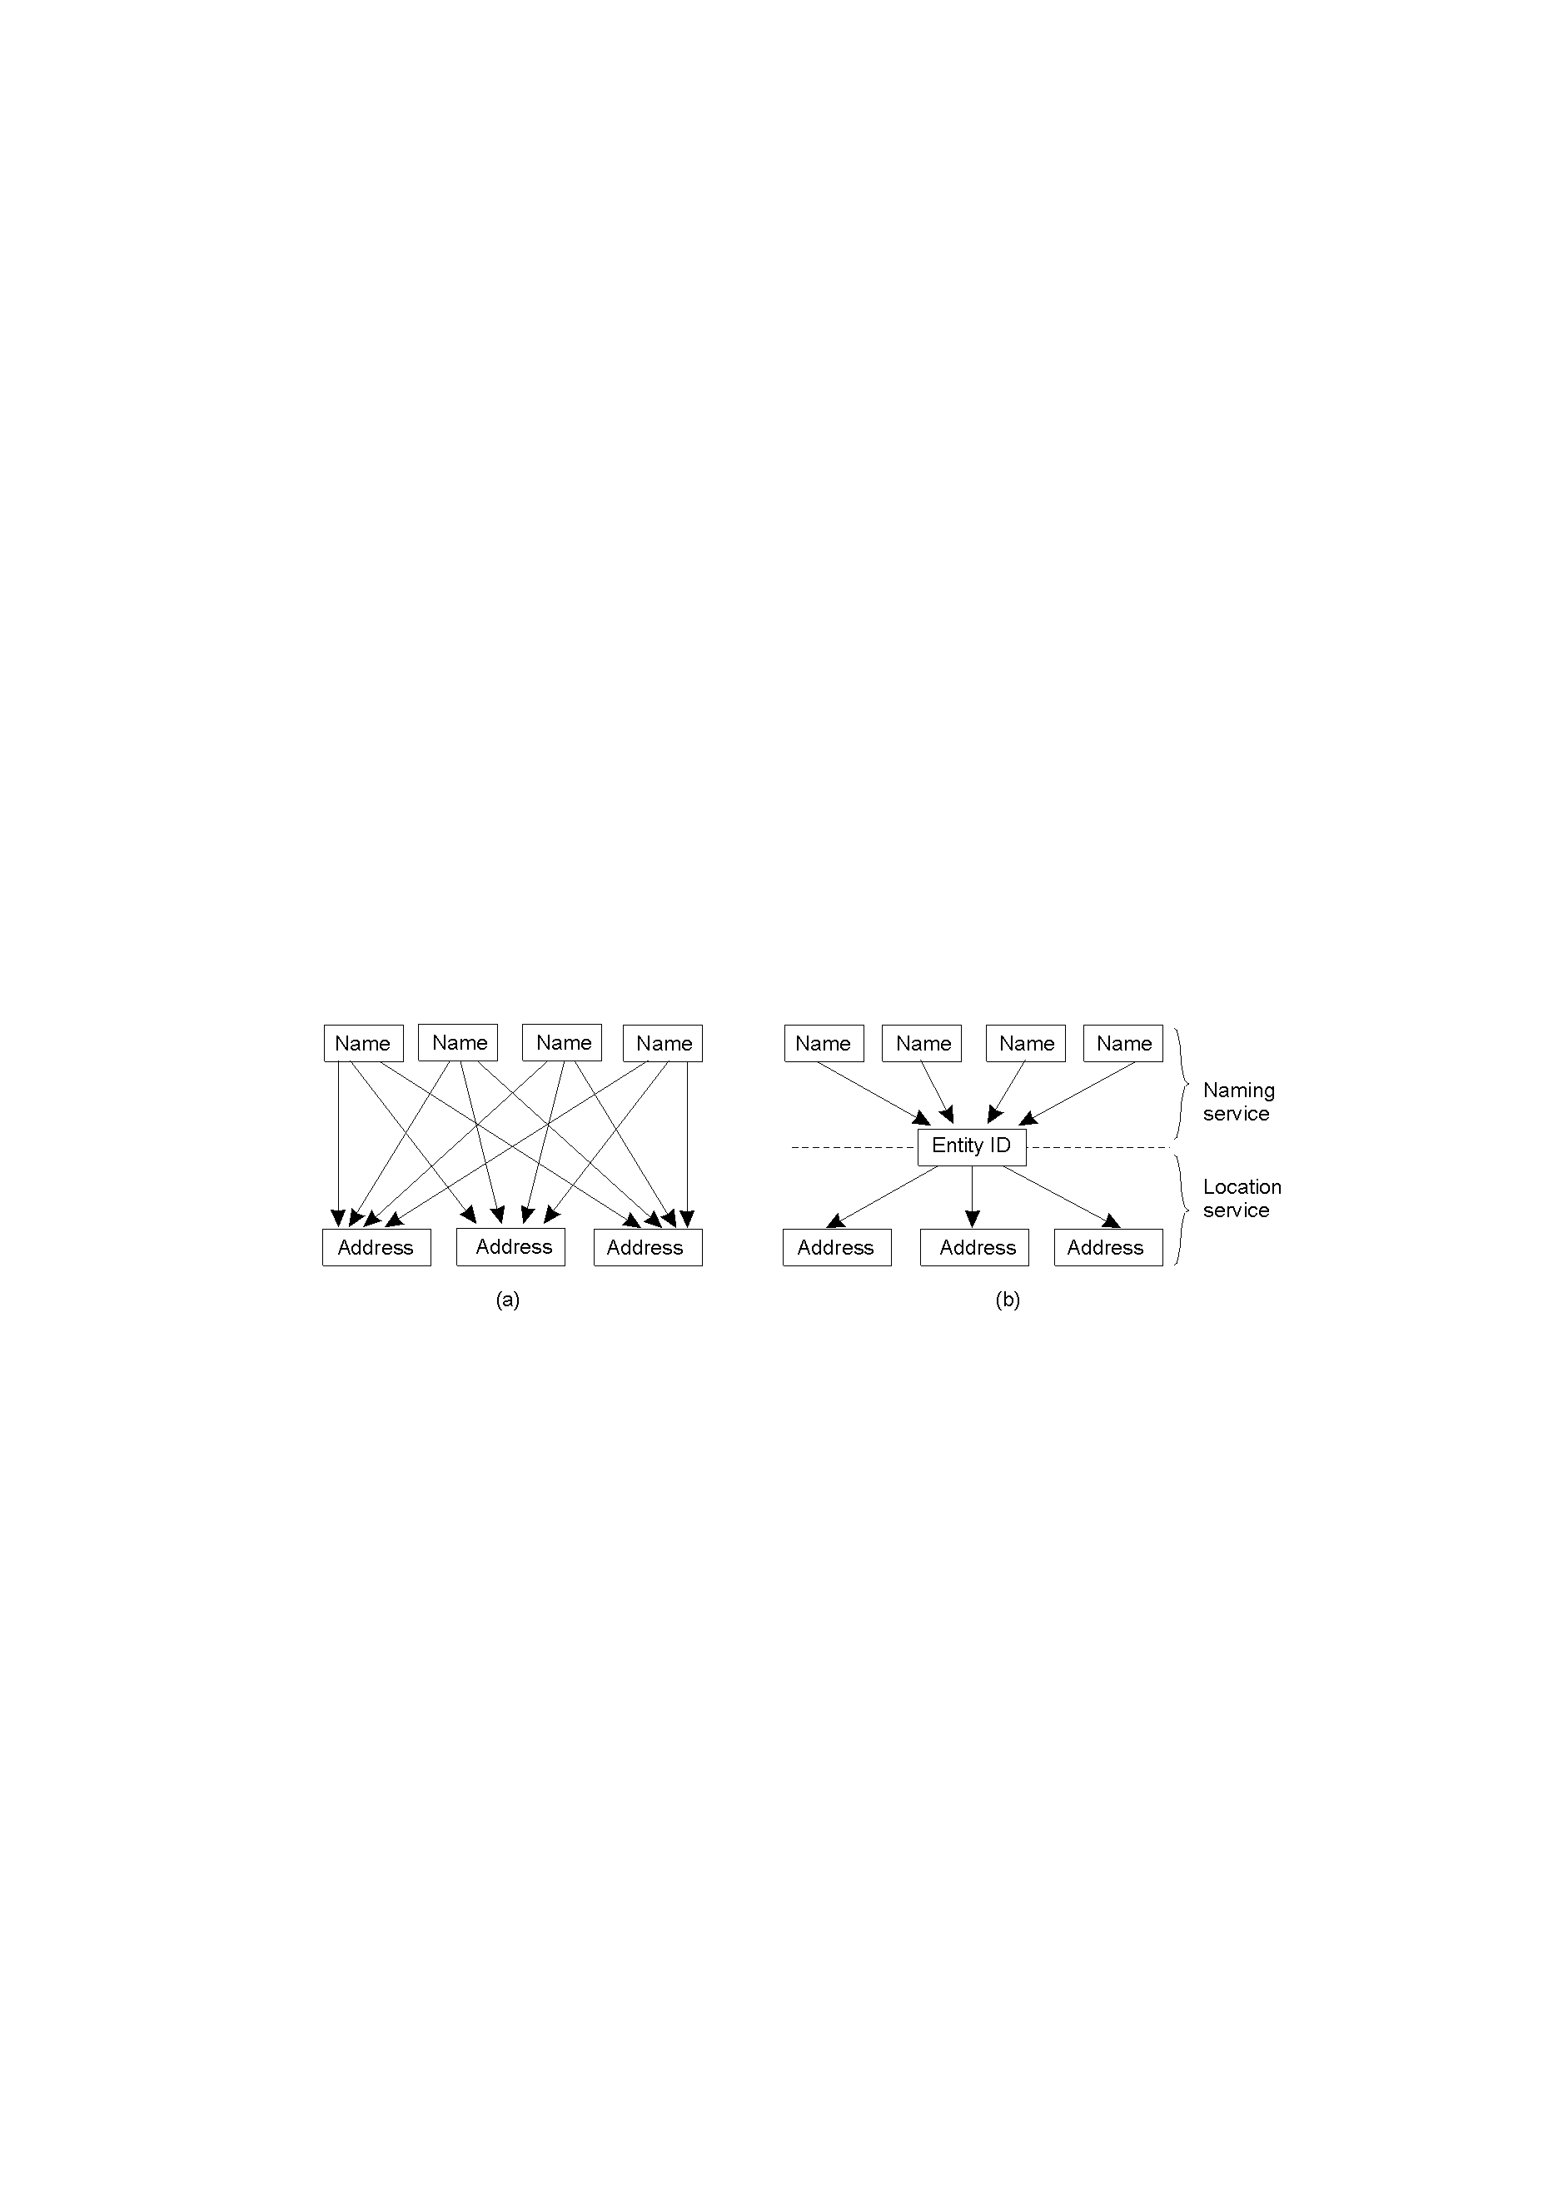
Naming vs. Location Services
Direct, single-level mapping between names and addresses.
Two-level mapping using a “location service”.

Slide 34
Simple Solution #1
Broadcasting and Multicasting technologies.
  Sending out “where are you?” packets …
  Address Resolution Protocol (ARP) used by the TCP/IP suite for resolving IP names to underlying networking technology addresses.
  Works well (on LAN’s and other broadcast technologies) but doesn’t scale well.

Slide 35
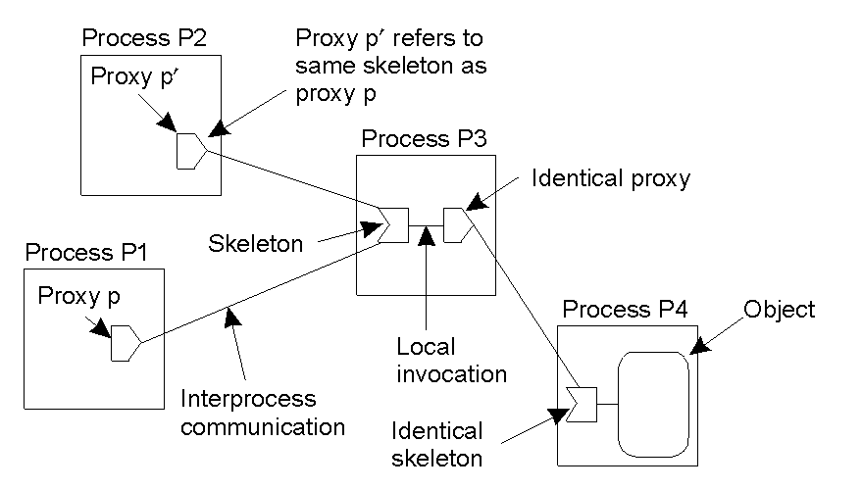
Simple Solution #2: Forwarding Pointers
Principle of forwarding pointers using (proxy, skeleton) pairs: after each relocation, the process leaves a pointer to where it moved to next. Simple to implement, but has a number of disadvantages.

Slide 36
Disadvantages of Forwarding Pointers
A chain can become very long, and the “lookup” eventually becomes prohibitively expensive.
All the “intermediate locations” must maintain their chains for “as long as needed” (however long that is).
Big vulnerability: broken links (break a link and a forwarded entity is lost… oh, dear).

Slide 37
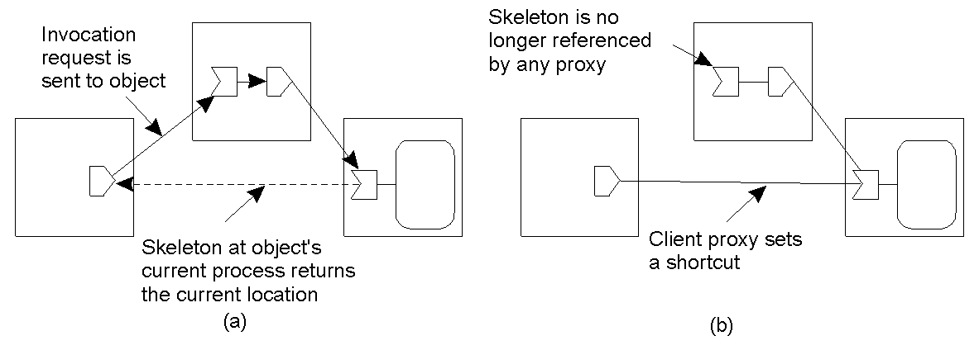
Simple Solution #2, cont.
Somewhat of an improvement: redirecting a forwarding pointer, by storing a shortcut in a proxy. However, to avoid large chains of pointers, it is important to reduce chains at regular intervals (easier said than done).
Of course, the more pointers there are, the more latency problems there are.
And… this solution does NOT scale well.

Slide 38
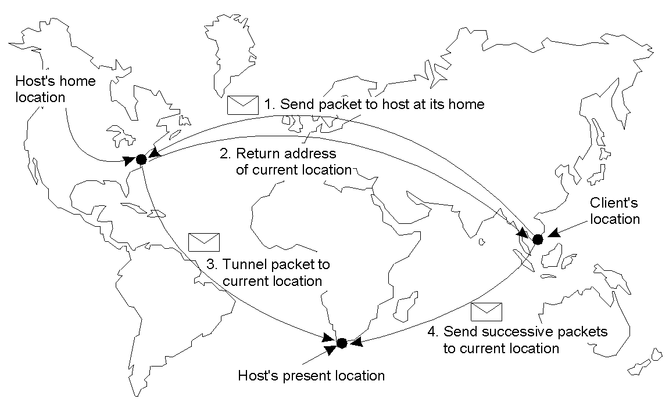
Solution #3: Home-Based Approaches
An entity has a “home” which can be contacted in order to determine the mobile entities current location. This is the principle employed by the Mobile IP technologies (with its “home agents” and “care-of addresses”).
Drawbacks: increased latency and permanent moves.

Slide 39
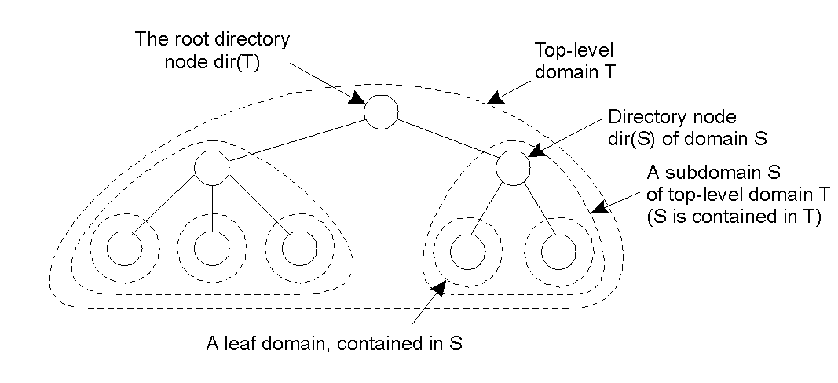
Solution #4: Hierarchical Approaches
Hierarchical organization of a location service into domains, each having an associated directory node – it can be useful to think of this as a “dynamic” name space.

Slide 40
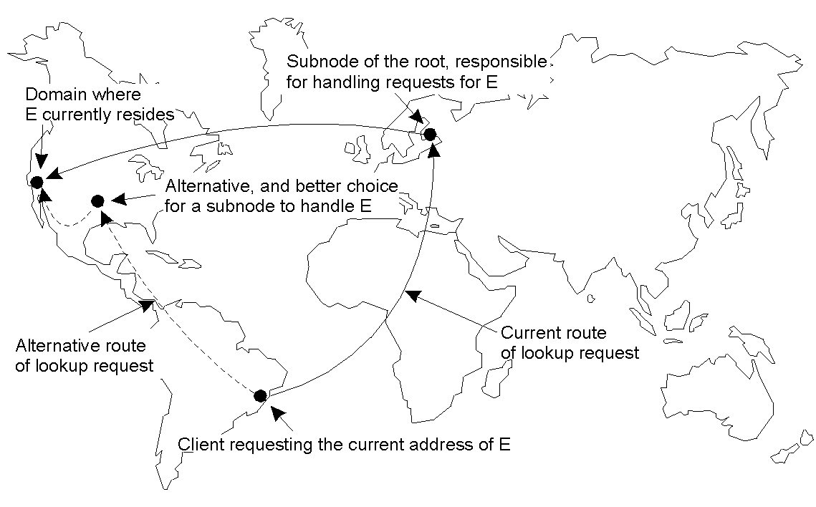
Scalability Issues with the Hierarchy
The scalability issues related to uniformly placing subnodes of a partitioned root node across the network covered by a location service.

Slide 41
Distributed Garbage Collection
Removing unreferenced entities can be tricky.
As soon as a entity is no longer required, it (and any copies of it and/or references/pointers to it) needs to be removed from the distributed system.
  e.g, just look at the mess of unreferenced HTML documents (“broken links”) on today’s Internet
[As an aside: part of the XML technology hopes to fix this problem… the jury is still out on this one].

Slide 42
Removing Unreferenced Entities
Managing the removal of entities in a distributed system is often difficult.
  Consider: is every reference to an entity an intention to access it at some later date?
It is not acceptable to never remove an entity – all garbage needs to be collected.
  Consequently, a number of Distributed Garbage Collection mechanisms have been devised.

Slide 43
What’s the Problem?
Simple: an unreferenced entity is no longer needed and should be removed from the DS.
A sick twist: a reference to an object which references another object, which in turn references another object, which references the first object (forming a “cycle”) needs to be detected and removed.
Garbage collection is well understood in uniprocessor systems and easily implemented. Things are considerable more complex when it comes to DSes.

Slide 44
Critical Questions
What type of communication is required to maintain references and perform distributed garbage collection?
What happens when the communications system is subject to process failures and errors?
  A number of solutions are proposed.
  Unfortunately, each only solves a part of the problem.

Slide 45
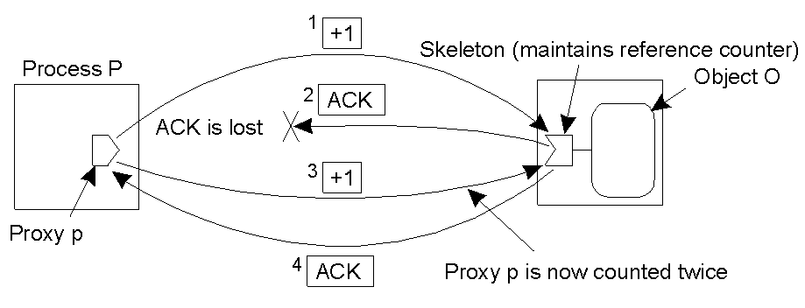
Generic Solution: Reference Counting
Increment at counter when an object is referenced.
Decrement a counter when an object reference is no longer needed.
Delete the object when the reference count is zero.
Leads to a number of problems, mainly due to unreliable communications systems.

Slide 46
Adding Robustness
Lost acknowledgements are easy to detect and deal with (a problem that has been solved by many other networking technologies).
Duplicates can also be handled.
A number of reliable enhancements to simple reference counting exist, but suffer from performance and scalability problems (they are also complex):
  Weighted Reference Counting
  Generation Reference Counting

Slide 47
Enhancements to Counting
Reference Listing: a reference count is not maintained. Instead, as list of proxies that point to the object is maintained by the object.
  The list has some important properties: if a proxy is already in the list, adding it again does not change the list. Also, if a proxy is not in the list, removing it from the list does not change the list.
  Reference Listing is said to be “idempotent” (an operation can be repeated any number of times without affecting the end result). So a proxy can keep adding/removing itself from the list until an ACK is returned.
Key point: duplicates are OK, and reliable communications is NOT required.

Slide 48
Think About This …
Increment and Decrement are not idempotent.

Slide 49
More on Enhancements
Reference Listing is used by Java’s RMI.
  The object keeps track of those remote processes that current have proxies to it.
Big disadvantage (with all Reference Listing systems): they scale poorly when there’s many references to the list.
Alternative: Reference Tracing.
  Keeps track of every object in the distributed system.
  A fine idea, but inherently unscalable (and a bit complex, too).

Slide 50
Naming: Summary
Names refer to entities, which are organised into name-spaces.
  Address: an entities access point.
  Identifier: one-to-one mapping to an entity.
  Name: human friendly descriptor.
Traditional naming systems include
  DNS and X.500.
Neither are suited to distributed systems which must support mobile entities.

Slide 51
Naming: Summary, continued.
Four approaches to finding/naming mobile entities:
  Broadcasting/multicasting: only works on LAN’s.
  Forwarding pointers: large chains cause problems.
  Home based systems: e.g. Mobile-IP.
  Hierarchical, dymanic domains.
Removal of “no longer needed” entities is important.
Distributed systems garbage collection technologies are organised around:
  Simple reference counting systems.
  Reference tracing.
  Reference Lists.
    All have their advantages/disadvantages.
RESEARCH CONTINUES…

